Slide 3
Q. Calculate the effective resistance R’_{L} seen looking into the primary of a 25:1 transformer ratio connected to an output load of 8Ω.

Slide 4

Solution: Given N₁ = 25 , N₂ = 1 , n = N₂/N₁
$$R_{L}^{′}=\frac{R_{L}}{n^{2}}$$
= [N₁/N₂]²R_{L}
= [25]² x 8
= 625 x 8 = 5000 Ω
= 5 k Ω

Slide 11
Q. Class A power amplifier has a transformer as the load. If the transformer has a turns ratio of 5 and the secondary load is 100 Ω, determine the maximum ac power output. Given that zero signal collector current is 100 mA.

Slide 12
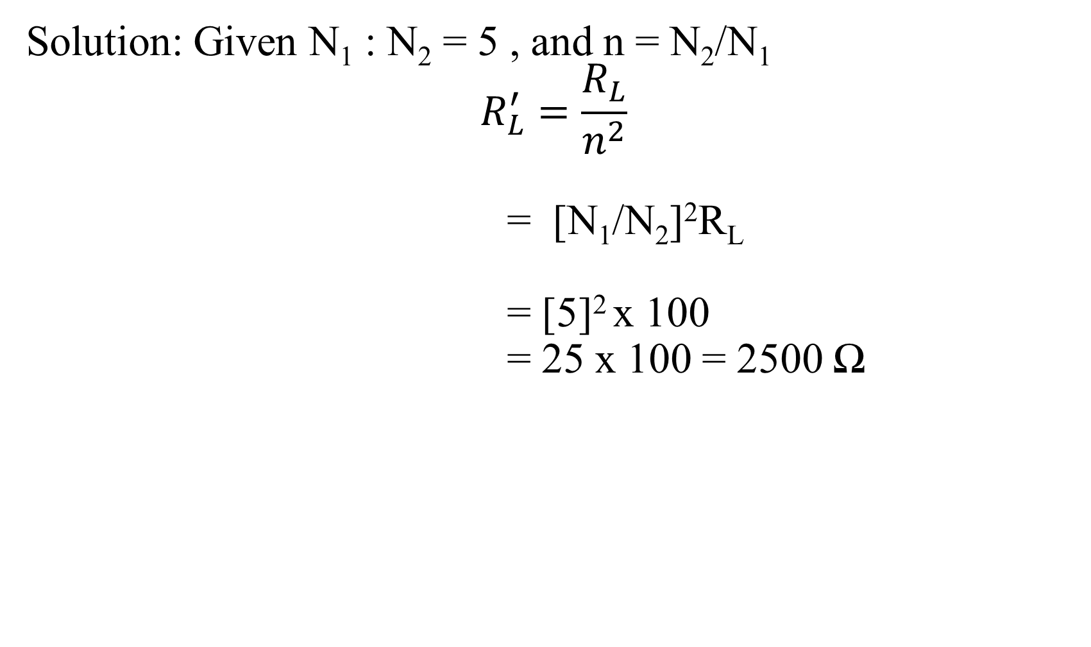
Solution: Given N₁ : N₂ = 5 , and n = N₂/N₁
$$R_{L}^{′}=\frac{R_{L}}{n^{2}}$$
= [N₁/N₂]²R_{L}
= [5]² x 100
= 25 x 100 = 2500 Ω

Slide 13

Therefore, maximum ac power output,
$$P_{ac(max)}=\frac{1}{2}I_{c}^{2}R_{L}^{′}$$
= (½)(100 x 10⁻³)² x 2500
= (½) x 25
= 12.5 W

